Slide 1
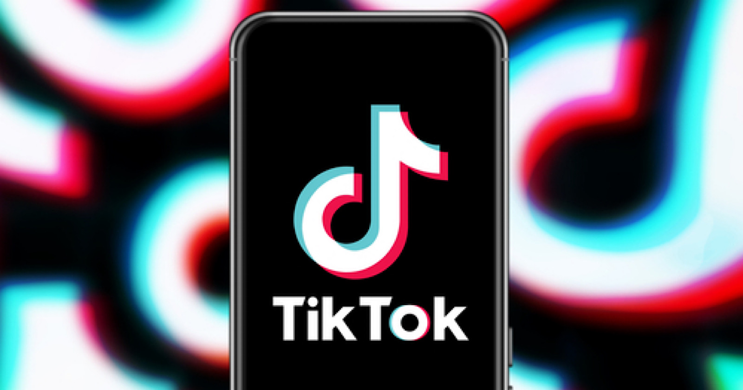
Tick Tock: Is it Time to join TikTok?
By: Nikki Hannaway

Slide 2
About Me
Nikki Hannaway, Senior Account Executive with a focus on social media, influencer marketing and public relations.
Co-Founder of Cravecle, one of the top-rated Instagram accounts in Cleveland according to Cleveland Scene.
Passionate photographer and social media consultant that loves helping local businesses.

Slide 3
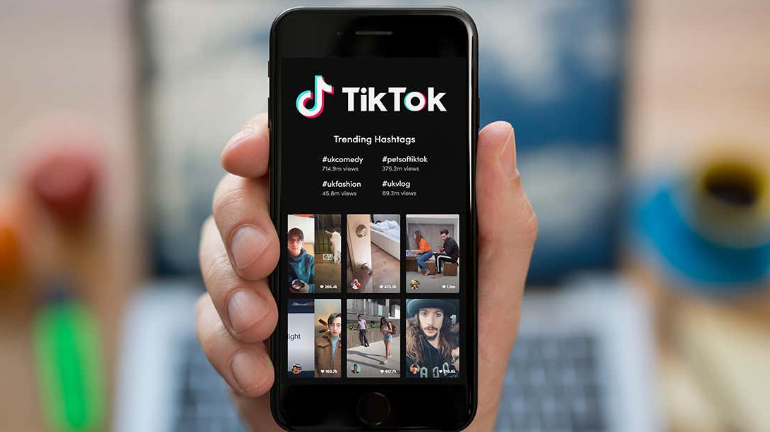
What is TikTok?
TikTok is a short-form, video-sharing app that allows users to create and share 15-second videos, on any topic with more than 800 million users.

Slide 4
Why Should I care about TikTok over other social platforms?
Localized Content
Despite being a global app, TikTok has a strong focus on localized content.
TikTok also sends personalized recommendations to each of its users. This ensures that TikTok users are always updated on the latest trending videos and are never out of ideas for video creation.
Localized hashtags: #CLE #Cleveland #VermilionOH #ExploreOhio

Slide 5
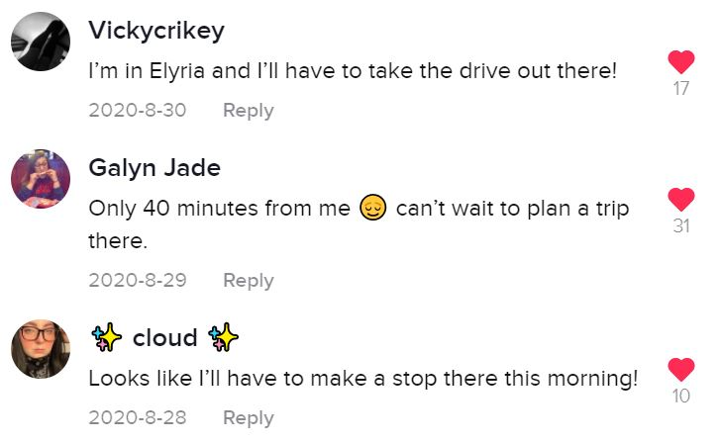
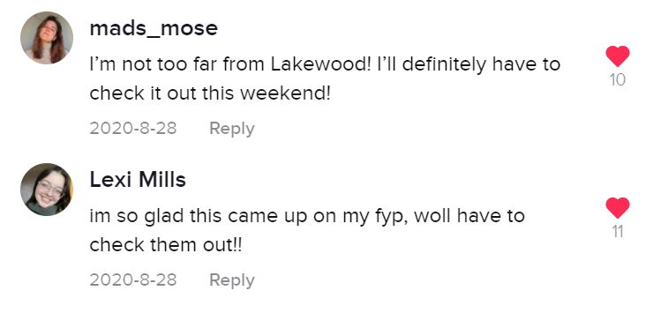
Key differentiators between tiktok and Instagram
I joined TikTok seven months ago and have 15K followers compared to Instagram, which I joined three years ago and have over 6K.
Significantly more engagement and action oriented on TikTok compared to Instagram.

Slide 6
The Rise of Video Content
Wyzowl’s State of Video Marketing 2021 reports that the number of businesses using video as a marketing tool has increased from 61 percent in 2016 to 86 percent in 2021.
Part of the reason for the rising investment is that consumers now watch an average of 18 hours of online video per week, up 2 hours from last year
People are twice as likely to share video content with their friends than any other type of content, including social media posts, blog posts/articles and product pages.
Notes:
https://www.forbes.com/sites/marciaturner/2020/03/31/using-tiktok-to-build-your-business/?sh=7bacd83b5846
https://www.wyzowl.com/video-marketing-statistics/

Slide 7
How TikTok Can Drive business
Where TikTok shines is in generating brand awareness and engagement.
Users that can combine entertaining or informative content in a 15- or 60-second video clip have the potential to see almost immediate results.
Popular videos that show the benefits of a certain product can cause it to sell out in stores almost immediately. Restaurants and stores have benefited from the fame, as the visual appeal of certain types of food or the layout of a store can cause thousands of people to flock to places they otherwise wouldn’t have known about.
Notes:
https://huntnewsnu.com/65048/city-pulse/the-effects-of-tiktok-virality-on-small-businesses/

Slide 8
How do I set up a Tiktok account?
1. Download TikTok from Google Play or the App Store. 2. Open the app. 3. Go to Me. 4. Choose a method to sign up.
Notes:
https://huntnewsnu.com/65048/city-pulse/the-effects-of-tiktok-virality-on-small-businesses/

Slide 9
Do’s and Don’ts on TikTok
Do keep it light and fun. TikTok is an opportunity to show a more creative and humorous side of your brand.
Do be candid. Content that’s humorous, candid, and informal performs the best.
Do use music.
Do format properly for the platform. Shoot vertical not horizontal.
Do mimic content that’s trending. Whether it’s a dance move or a popular trending song, if it fits in with your brand, leverage it! That will drive additional views to your page.
Do collaborate with influencers and partners. Tapping into established followings can boost engagement and awareness quickly.
Don’t make a hard-sell ad.

Slide 10
TikTok Video Examples
Using your photo app, click video and shoot vertically a variety of different pieces of your business.
Movement and human elements help tell stories.
In the app, upload the videos in the order you want them to appear.
Once uploaded cut them down and pair them with a song.
Once you are happy with the video post it and leverage hashtags like #Ohio, #OhioCheck, #VermilionOH #44089Shop, etc.

Slide 11
Case Study: Remixx Ice Cream
Cravecle partnered with Remixx Ice Cream Shop in Lakewood on a giveaway where we came in and took video of the business and the ice cream flavors we ordered.
We tied in a giveaway where users had to like the post, follow both of our accounts and comment tagging a friend.
Results
Drove over 200 new follows for Remixx’s account, previously had 75 followers.
15.3K Video Views with 42h:2m:2s total watch time
1,482 likes, 252 comments and over 200 video shares
Notes:
https://huntnewsnu.com/65048/city-pulse/the-effects-of-tiktok-virality-on-small-businesses/

Slide 12
Key Takeaways
Whether or not you decide to download TikTok for your business, there are still some key takeaways that can be applied outside this platform.
Video content is continuing to grow. Leverage that.
Use hashtags to appear on a local level to reach out to potential customers in your area. #44089Shop, #44089Eat
Post frequently a mixture photos and videos on your social platforms.
Repurpose that content across your other social platforms. Don’t just focus on Facebook.
Support one another. Social engagement boosts your account.

Slide 13
Questions?
If you have any further questions or need social media consulting, please email me at Hannaway.Nicole@gmail.com.

